Slide 1
School Management System
Mahmoud Gamal
MERN Stack Developer

Slide 2
Overview :
The School Management System is a comprehensive platform designed to streamline administrative tasks and enhance communication in educational institutions.
It aims to simplify processes for school administrators, teachers, parents, and students.
By leveraging technology, our system enables efficient management of student enrollment, attendance tracking, grade management, parent communication, and timetable generation

Slide 3

Key Features:
Student Enrollment: Simplify the registration process by allowing administrators to enter and manage student information, ensuring a well-organized student database.
Attendance Tracking: Enable teachers to record and monitor student attendance, generating reports and notifying parents of their child's attendance status.
Grade Management: Streamline the grading process for teachers, allowing them to store, update, and calculate student grades. Progress reports can be generated and shared with parents.
Parent Communication: Facilitate seamless communication between teachers and parents, enabling announcements, progress updates, and addressing concerns through the system.
Timetable Generation: Automate the creation of school timetables, optimizing resource allocation and providing administrators with a user-friendly interface for modifications.
User authentication and authorization system to ensure secure access to the system.

Slide 4
Technology Stack :
Our School Management System is built using the PERN stack, which stands for PostgreSQL, Express.js, React.js, and Node.js.
PostgreSQL is used as the relational database to store and manage data.
Express.js provides a robust framework for building the backend server.
React.js is employed for developing the frontend user interfaces, providing an interactive and responsive user experience.
Node.js serves as the runtime environment for executing JavaScript code on the server-side.

Slide 5
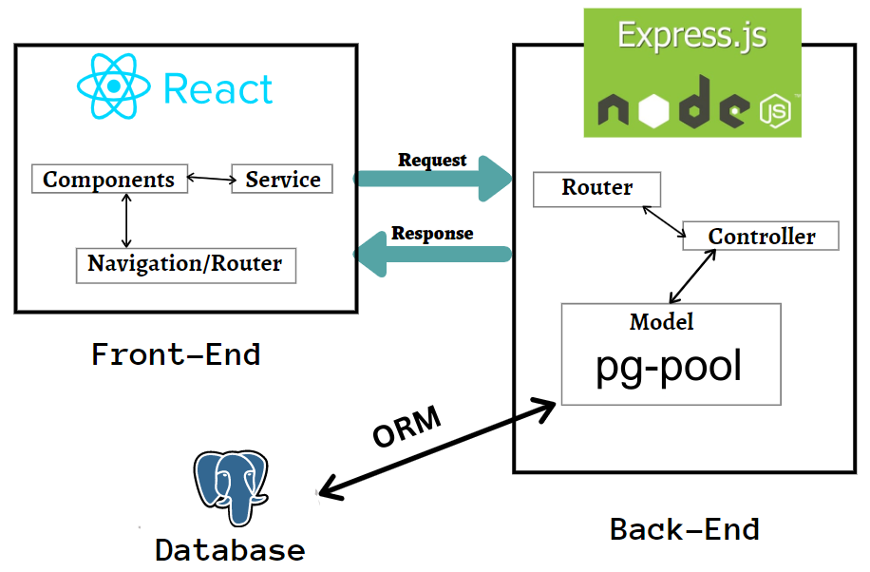
System Architecture :

Slide 6
Project Plan :
Week 1-2: Project planning and analysis, including defining project requirements, identifying endpoints, and creating a project plan.
Week 3-5: Backend development, including building the backend using Node.js and PostgreSQL, creating data models, APIs, and authentication.
Week 6-8: Frontend development, including building the frontend using React and Redux, designing the user interface, and integrating with the backend.
Week 9-10: Testing, including conducting unit tests, integration tests, and end-to-end tests to ensure functionality and quality.
Week 11-12: Deployment, including deploying the application to a server or cloud service, configuring the environment, and ensuring scalability and security.
Week 13-14: Maintenance, including monitoring the application, fixing bugs, and implementing new features based on feedback and user needs.

Slide 7

Skills Developed:
Understanding of database design and implementation using PostgreSQL
Proficiency in Node.js and its ecosystem of libraries and tools
Experience with web development concepts such as RESTful APIs, MVC architecture, and user authentication
Familiarity with frontend development using React and its ecosystem of libraries and tools
Understanding of state management using Redux
Project management skills, including task planning, time estimation.

Slide 8

Our next version of the school management system will include several new features and enhancements :
Enhanced user interface for improved user experience
Mobile app for convenient access on iOS and Android devices
Parent permission level to access their child's information
Customizable gradebook for flexible grading criteria
Advanced attendance management with real-time notifications
communication channels for seamless interaction
Enhanced security measures for data protection
Integration with Learning Management Systems for enhanced online learning

Slide 9

Conclusion :
In conclusion, our School Management System developed using the PERN stack offers a comprehensive solution to streamline administrative tasks and improve communication in educational institutions.
We are excited about the positive impact it can have on schools, enhancing efficiency and facilitating better collaboration .
Thank you for your attention and for being a part of our educational journey. We welcome any questions or feedback you may have. 😄

